Slide 1
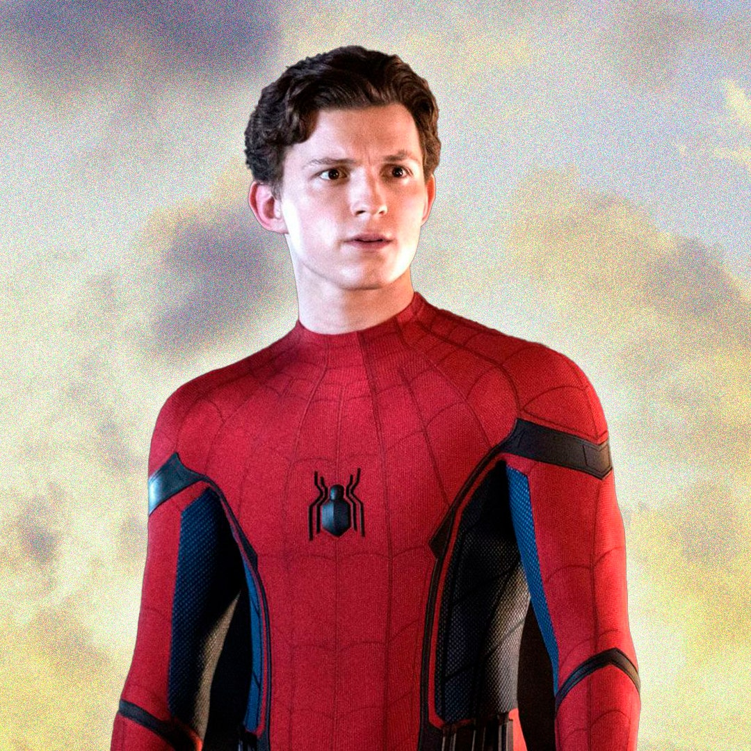
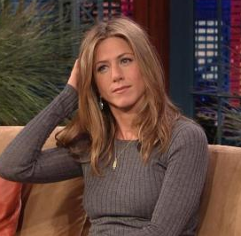
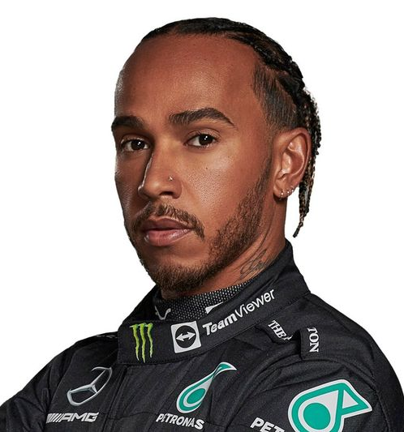
What do these celebrities have in common?

Slide 2
They’re all dyslexic

Slide 3
What is dyslexia?
It is something that many people have which means that they may find it difficult to read words, spell words, remember instructions or get themselves organised.

Slide 4
Dyslexic people often have strong visual, creative and problem-solving skills and are prominent among entrepreneurs, inventors, architects, engineers and in the arts and entertainment world.

Slide 5
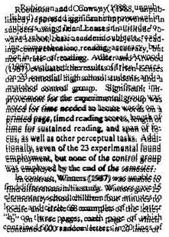
The page may look like this.

Slide 6
Or this…

Slide 7
Or this…

Slide 8
Or even
this.

Slide 9
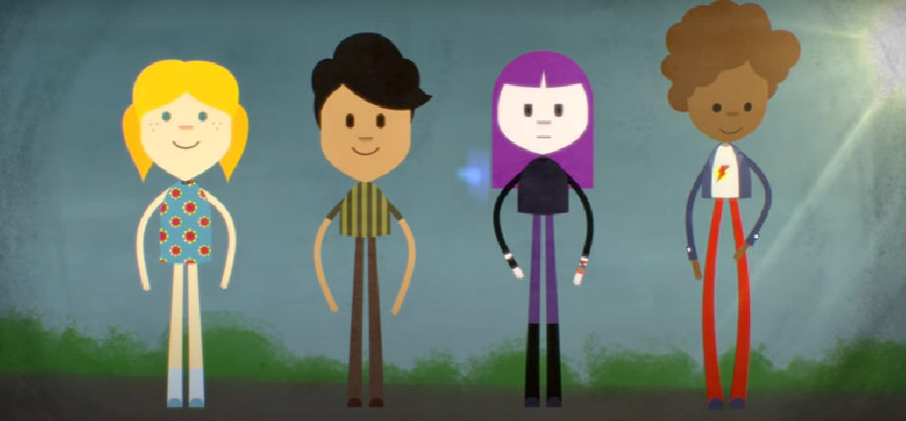
There is not just ‘one type’ of dyslexia… let’s find out more.
What is dyslexia? - British Dyslexia Association (bdadyslexia.org.uk)
https://www.bdadyslexia.org.uk/dyslexia/about-dyslexia/what-is-dyslexia

Slide 10
How can we help people with dyslexia at school?
An organised classroom with clear routines.
Using class iPads, reading pens or talking tins.
Giving time to think about a questions.
Using talk partners to be able to get your ideas out of your head.
Coloured backgrounds and a special font.
Revisiting reading and spelling strategies at the start of each year.
Whiteboards with coloured markers to practise spellings and sentences.
Using planning boards.
Sitting facing the board.
Different ways of learning in a lesson: listening, watching doing.

Slide 11
