Slide 1
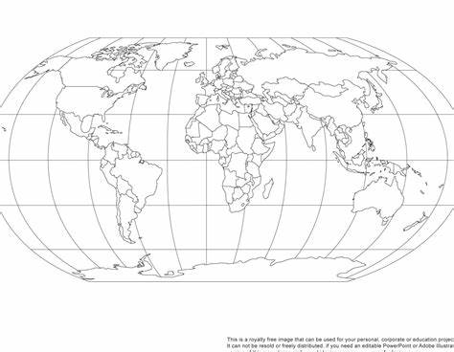
Literacy – Reading: This term, our class book is ‘Pugs of the Frozen North’ by Philip Reeve and Sarah Mcintyre. During our guided reading sessions, we will continue to develop our retrieval skills and develop our skills when explaining the meaning of words in context. We will also be identifying the important parts of a text extract.
Writing: Using our class text as a stimulus, we will write diary entries from the perspective of a main character, adverts for sleds and a setting description. We will learn how to use pronouns, the past tense, chronological order and inference. We will explore using fronted adverbials and using commas after these.
Maths: Addition and subtraction continues in this term with Y3 applying these skills when using 3-digit numbers, including exchanges. Year 4 will do likewise but using up to 4-digit numbers.
Y3 then move straight to multiplication and division – using their prior learning of counting up in 2s and 3s to help them multiply and divide by both of these. They will use their knowledge of the 2 times table to support them in exploring the 4- and 8-times tables..
Meanwhile, Y4 children spend some time understanding what area is and finding it by counting squares. They then move onto multiplication and division. First, they look at links between the 3/6/9 times tables and then focus on the 7s, 11s, and 12s.
All the children’s learning will be deepened and challenged through reasoning and problem-solving questions to embed and extend their learning.
Year 3/4 – Term 2
Worship theme: This term our collective worship theme is love. We will be considering what love means to us and why it is important.
Key Dates:
Odd socks day – Monday 13th Nov
Spotty socks for Children in Need – Friday 17th Nov
Parent Workshop, Mental Health – Mon 20th Nov
Dress Down Day - Friday 17th Nov
Parent E-Safety Workshop – Tues 28th Nov
Christmas Extravaganza - Friday 1st Dec
Secret Present Room – w/c 4th Dec
Christmas lunch/jumper day – Tuesday 19th Dec
Christmas Church Service – Wednesday 20th Dec
Where in the World?
World Geography
PSHE: In PSHE our focus is on celebrating difference and we will be thinking about families and positive ways to solve conflicts. During antibullying week, we will explore the theme ‘One Kind Word’ and what this means to us at Downton.
Geography: We will be developing our global mapping skills. The children will use maps, atlases and globes to locate Continents, Countries and Capital Cities. We will also explore key aspects of physical geography and locate features using simple grid references.
Art: This term we will be exploring Van Gogh’s unique style of drawing and painting, which uses short lines, marks and swirls. We will be looking at lines and patterns in natural objects, particularly fossils (to link with our Science unit). Inspired by Van Gogh's techniques, we will then be creating our own art pieces.
RE: In RE, we will be learning about Incarnation, exploring symbolism and asking ‘What is the Trinity?’ We will explore what the word gospel means and why it is important to Christians.
PE: Our Indoor PE this term is gymnastics. The children will before a short sequence on mats, using a range of jumps and rolls. Our outdoor PE is Quicksticks. The children will develop their skills dribbling the ball, passing and begin to tackle a player safely.
Science: Our science topic this term is fossils and soils. The children will learn how fossils are formed and about the life and discoveries of Mary Anning. They will investigate what soil is made of and experiment to explore properties of different soils to understand how different types are more free draining as well as developing simple soil profiles.
We will also be observing signs of seasonal change in our local environment.
French: We tackle a core unit this term including colours, counting to 20 and saying what you like.
Music: This is blocked into whole days over the Autumn term and our first day will see the children having a chance to really immerse themselves in rhythm and pitch as well as how music is written onto a stave using notes and symbols. They will use this knowledge whilst singing and playing instruments.
Computing: We will learn about the importance of online safety and learn strategies to keep safe online. The children will also use the programmes 2blog and 2connect to create mindmaps.

Slide 2
This is blocked into whole days over the Autumn term and our first day will see the children having a chance to really immerse themselves in rhythm and pitch as well as how music is written onto a stave using notes and symbols. They will use this knowledge whilst singing and playing instruments

